Slide 1
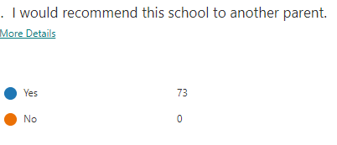
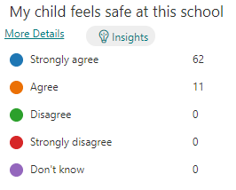
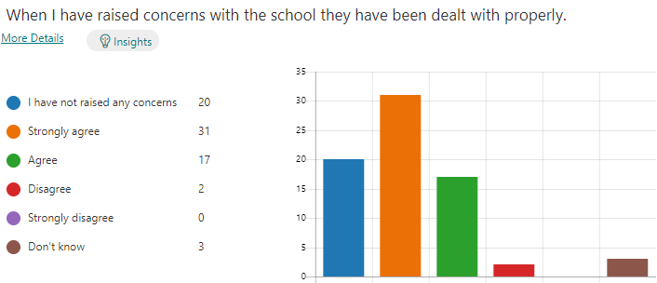
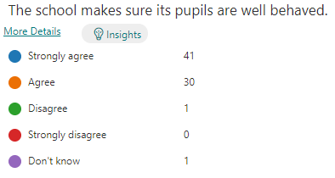
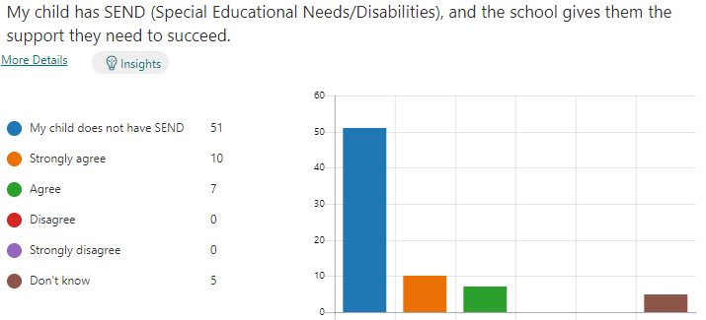
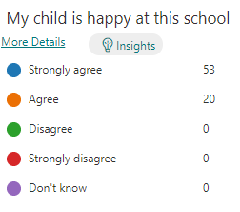
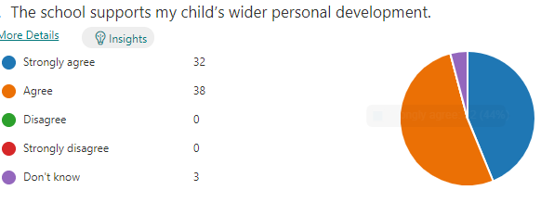
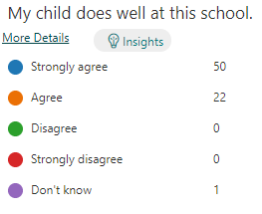
Parent Feedback
November 21

Slide 2

Parent Feedback – November 21
Ran so well, great teaching staff and all friendly.’
‘My child enjoys coming to school, the teachers/ staff are all friendly and helpful.’
‘Communication is excellent.’
‘The school is fantastic and my daughter loves being a pupil there. I feel that staff make parents feel very much as though they are part of the school community. It is a happy, calm and supportive environment - thank you!’
‘It's been great since it first opened its doors!!’
‘Communication and the teacher really seem to care’
‘Learning subjects – communication’
‘Making each child grow in their own way’
‘Takes care of my child and keeps me informed of any concerns’
‘Sense of community, fantastic range of learning opportunities’
‘Communicates with parents well. Informing them of any issues or concerns. I feel comfortable talking to the teachers about concerns. I feel the school has a warm and pleasant feel about it.’
‘I feel the staff and pupil relationship is lovely, well balanced with education and being caring.’
‘The school appears to be well organised, friendly and all staff are very approachable’
‘Looking after the children, building up their confidence, good curriculum, plenty of activities’
‘Caring and safe environment for the children. Always making sure every child is involved and not left out. Brilliantly communicates with parents and responds well to any queries or concerns’

